Slide 1
Project Update – Week 5
Tora Gao, Zheng Shi, Leon Zhang

Slide 2
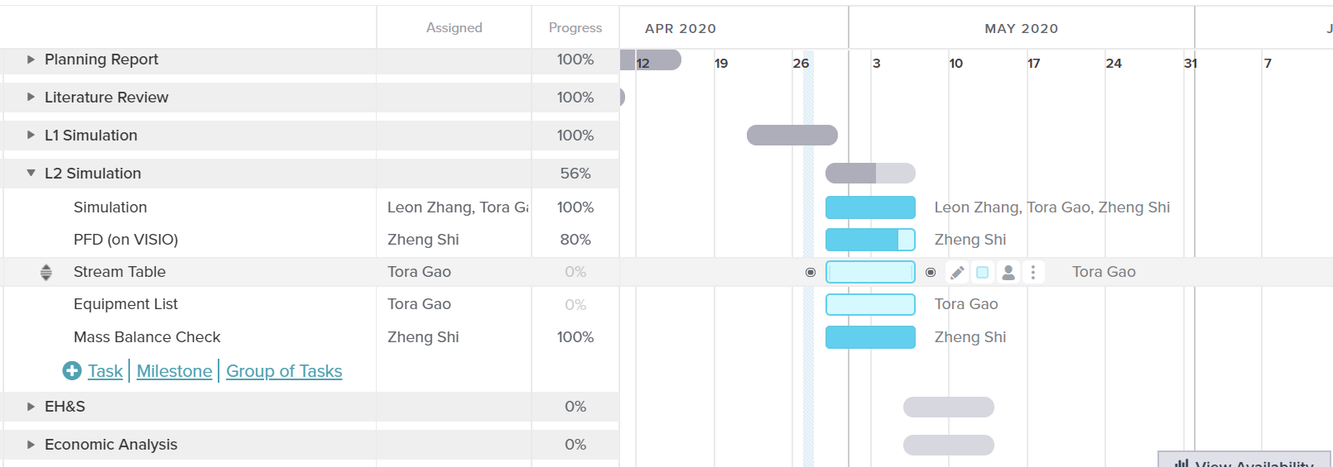
Gantt Chart
Notes:
https://prod.teamgantt.com/gantt/schedule/?ids=2115888#&ids=2115888&user=&custom=&company=&hide_completed=false&date_filter=&color_filter=

Slide 3
Tasks Completed
Managed to converge the downstream process without warning/error
Finished L2 simulation
PFD mostly completed

Slide 4
Unexpected hurdles and Potential Solutions
Unexpected Hurdles:
Big recycle stream does not converge in simulation (we fixed it)
Potential Solutions:
Have a 2% purge, “magically” separate minute amounts of impurity out of recycle stream, change conversion parameters

Slide 5
Short-Term and Long-Term Plans
Short-Term
Finish up PFD
Obtain specific operating parameters (voltage, current, energy usage, etc.) for units such as PSA, electrlolyzer, etc.
Use heuristics to figure out the more specific specs for all the equipment.
CAPCOST
Long-Term
Confirm simulation
Final report components (economics, ES&H, etc.)

